Slide 1

The Embodied Brain Interoception
Dominique Makowski
D.Makowski@sussex.ac.uk
Notes:
1h

Slide 2
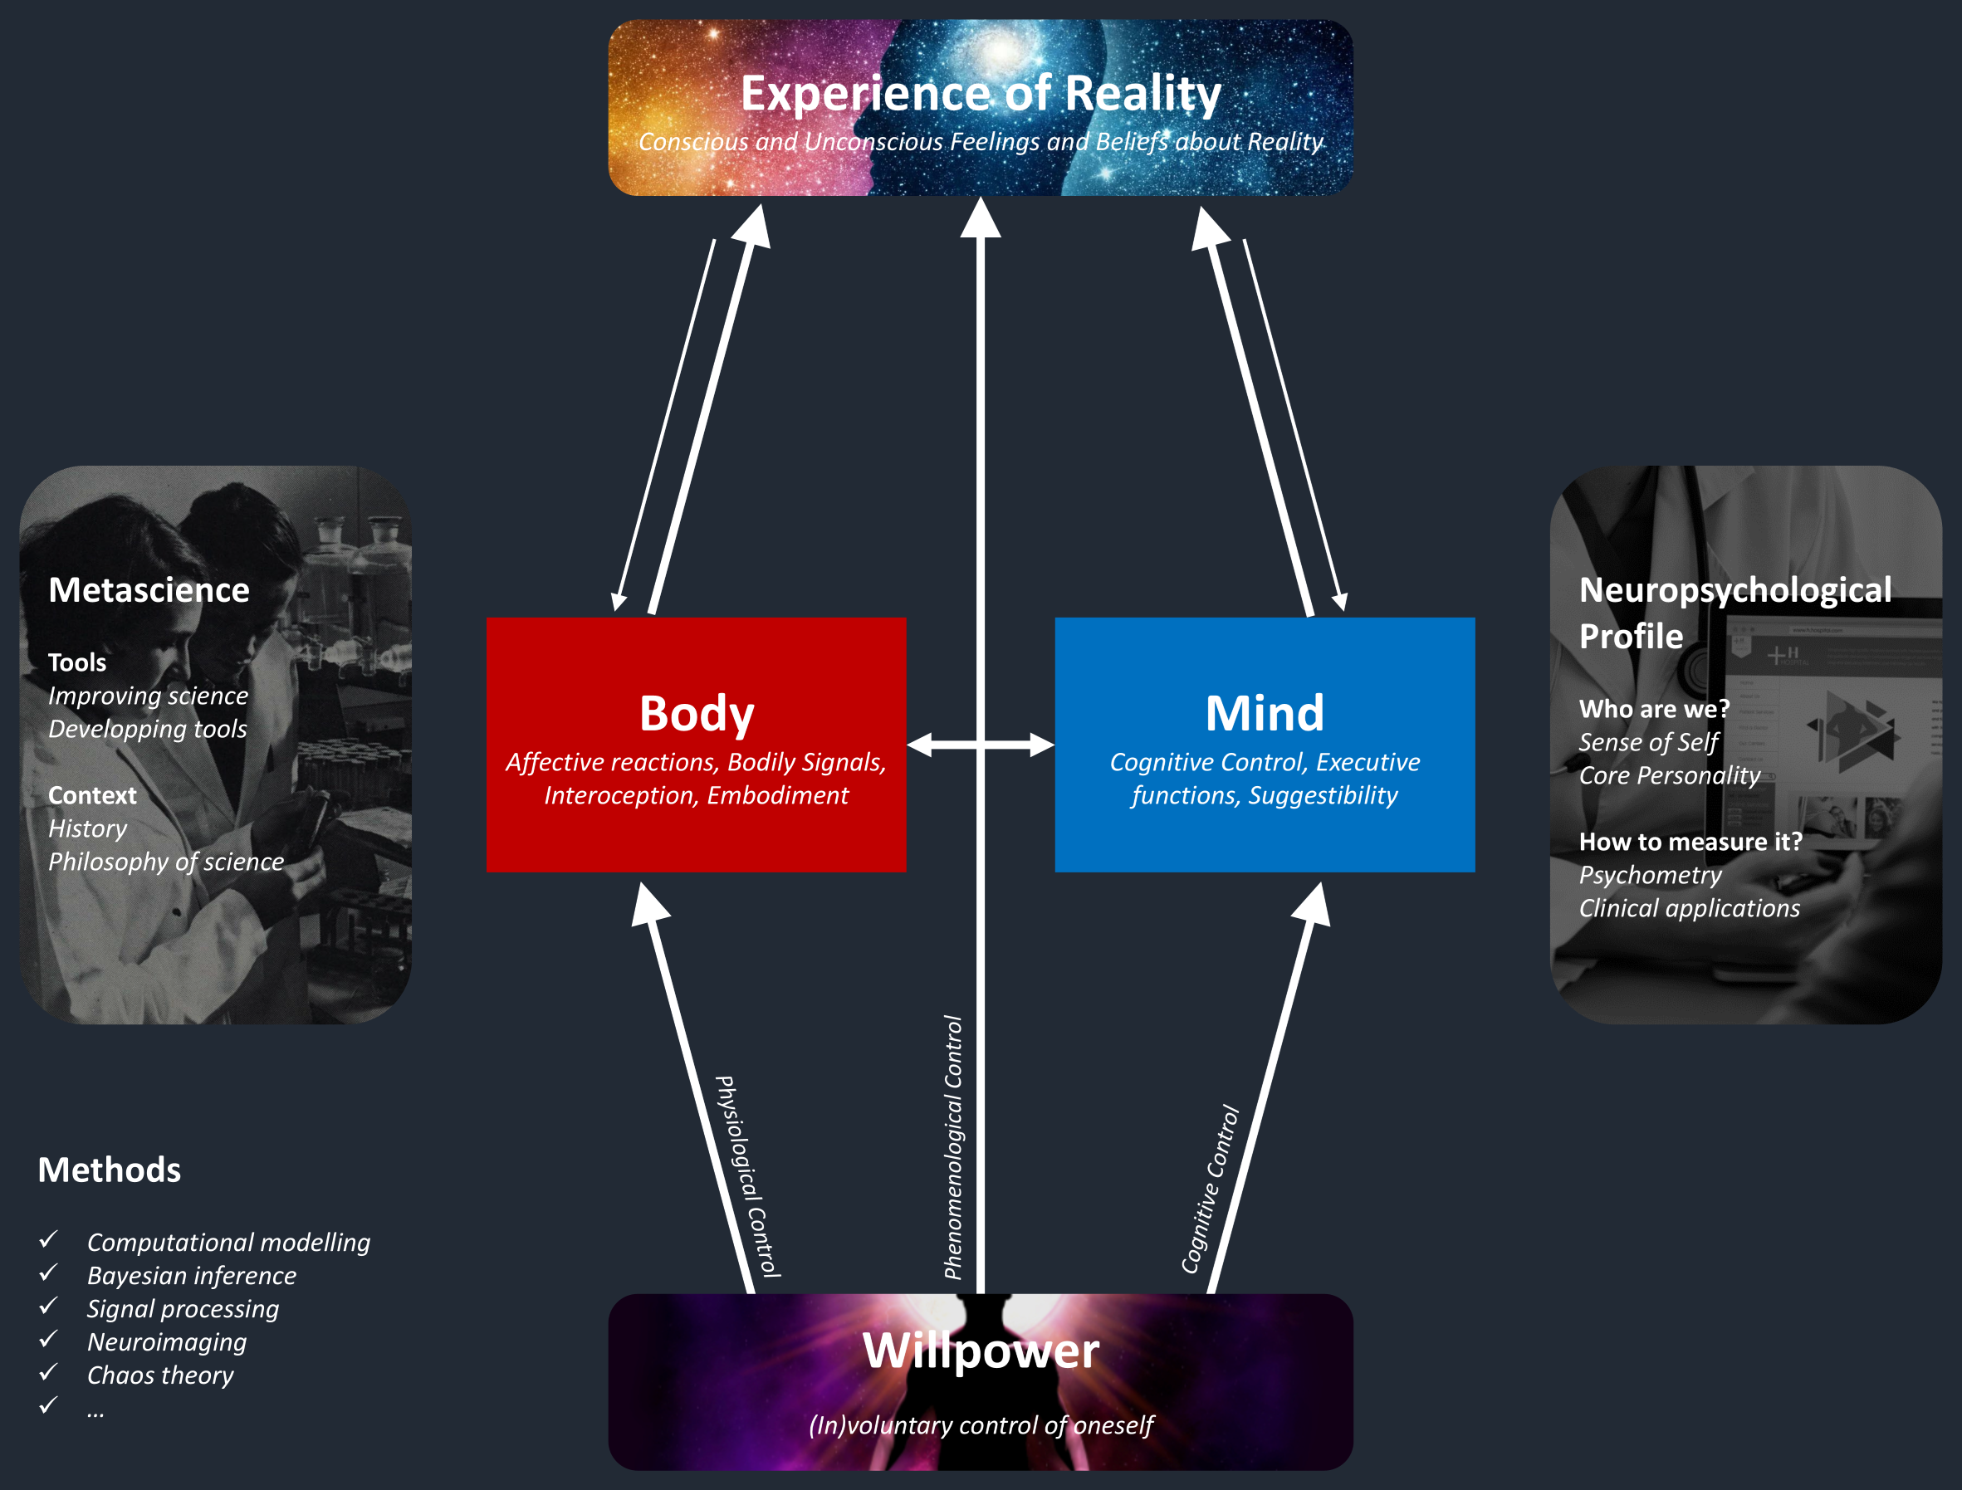

Introductions
Dominique Makowski
Reality Bending Lab
Role of the body in higher cognition
Slides: https://github.com/DominiqueMakowski/teaching
Contact:
D.Makowski@sussex.ac.uk

Slide 3
Body & Mind

Slide 4
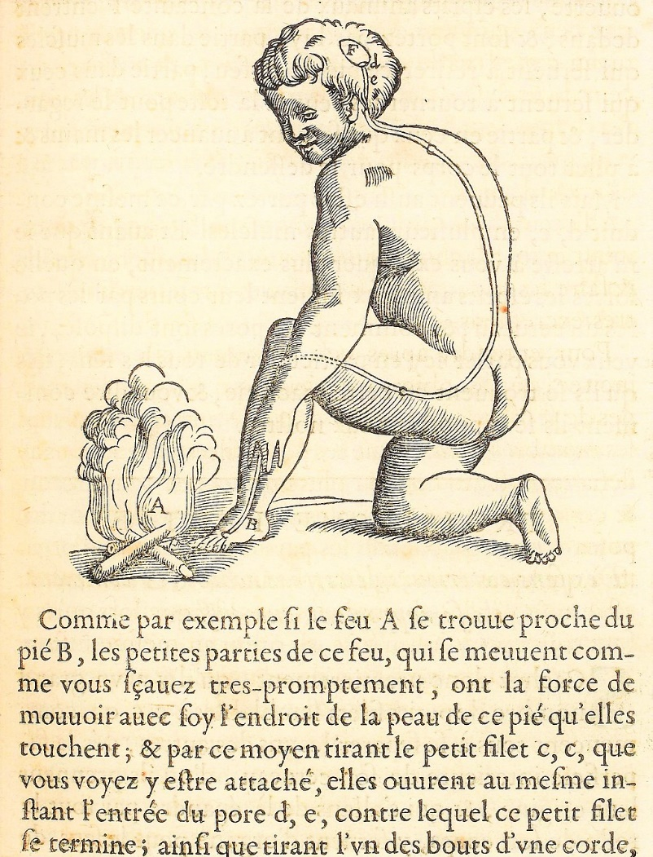
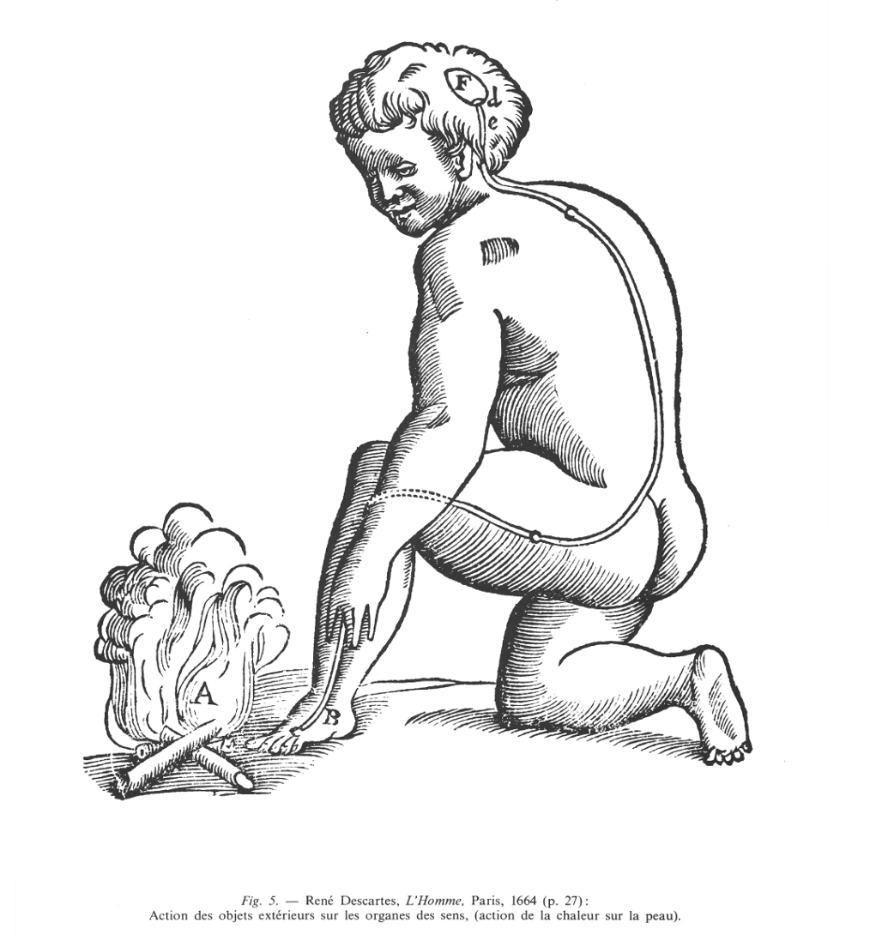
Ghost in the Machine
What is the relationship between the body and the mind?
Long philosophical tradition of “dualism” (e.g., Platonism, monotheisms)
In philosophy of mind, “Mind-body Dualism” denotes the view that the mind and body are distinct and separable, and/or that mental phenomena are non-physical
The “ghost in the machine” (Ryle, 1949) is a term originally used to describe and critique the concept of the mind existing alongside and separate from the body
If they are two different things: how does the mind control the body?
Descartes (1664) in « L'Homme » Treatise on Man
Body and mind are two fundamentally different “substances”
They interface at a special organ: the pineal gland
Body enables the mind to make actions (they do still interact)
Leibniz (1714) in « Monadologie»
Psychophysical parallelism: Mental and the physical phenomena do not interact but only coincide in a “pre-established harmony” (because God set it up that way)
Notes:
substance pensante (res cogitans) et la substance étendue (res extensa)
animal spirits
« Comme par exemple si le feu A se trouve proche du pied B, les petites parties de ce feu, qui se meuvent comme vous savez très promptement, ont la force de mouvoir avec soi l'endroit de la peau de ce pied qu'elles touchent ; et par ce moyen tirant le petit filet c, c, que vous voyez y être attaché, elles ouvrent au même instant, l'entrée du pore d, e, contre lequel ce petit filet se termine ; ainsi que tirant l'un des bouts d'une corde, on fait sonner en même temps la cloche qui pend à l'autre bout. Or l'entrée du pore ou petit conduit d, e, étant ainsi ouverte, les esprits animaux de la concavité F (glande pinéale) entrent dedans et sont portés par lui partie dans les muscles qui servent à retirer ce pied de ce feu, partie dans ceux qui servent à tourner les yeux et la tête pour le regarder, et partie en ceux qui servent à avancer les mains et à plier tout le corps pour le défendre. Mais ils peuvent aussi être portés par ce même conduit d, e, en plusieurs autres muscles. » (Descartes, l’Homme, 1664, p. 27)

Slide 5

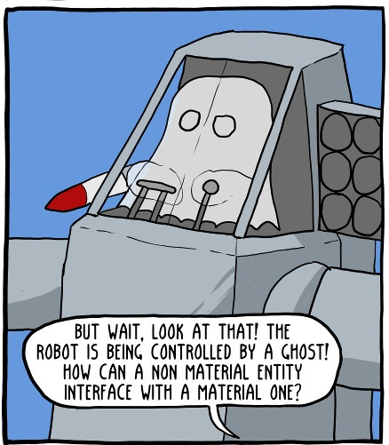
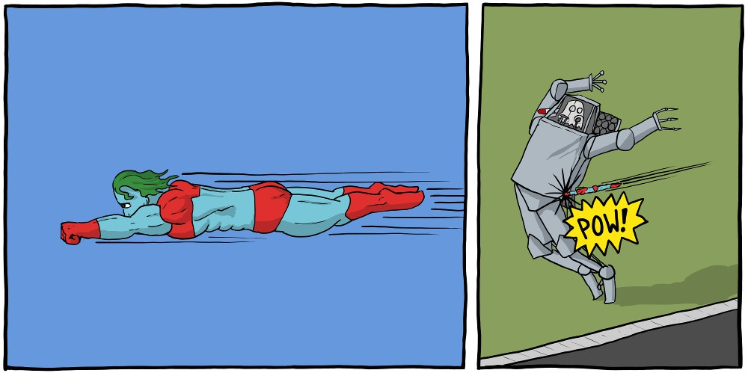
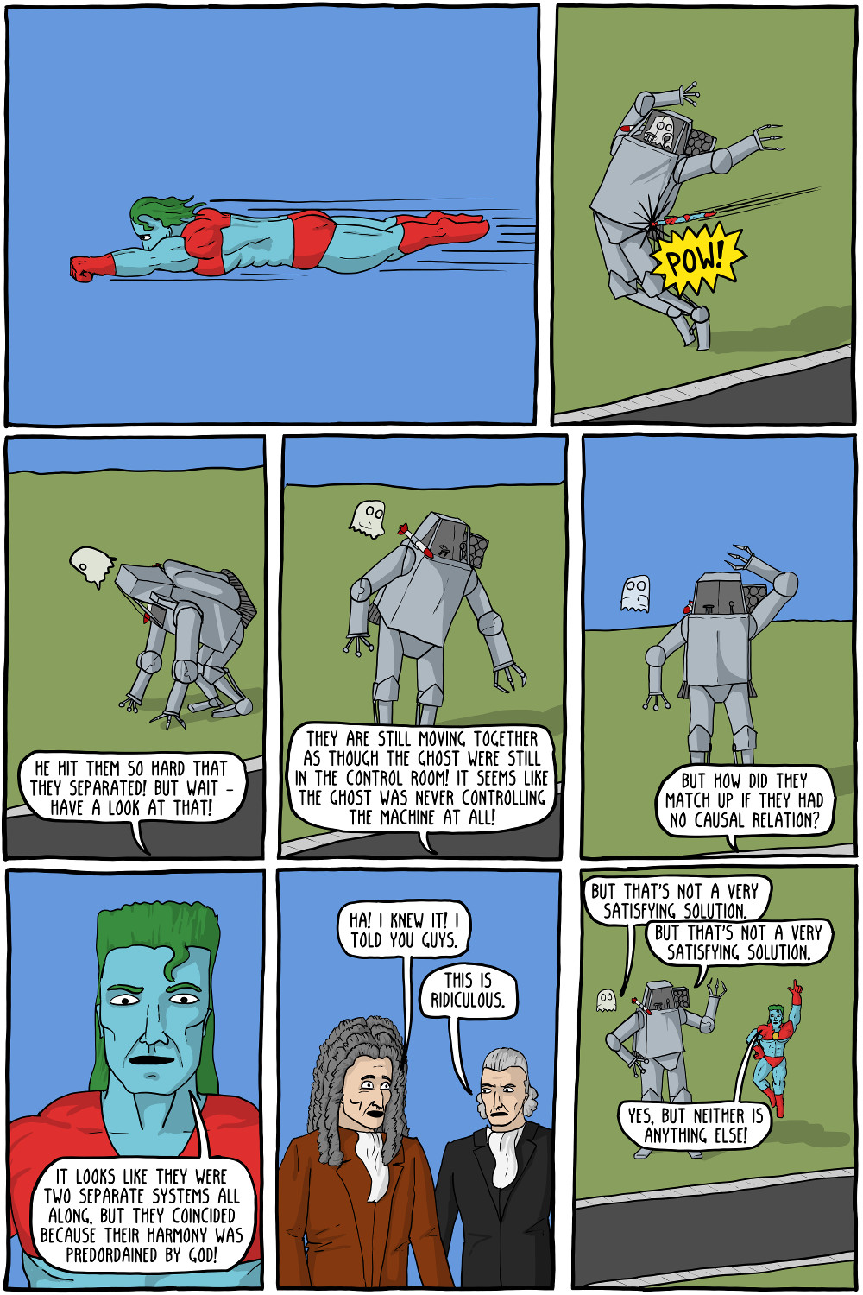
Ghost in the Machine
https://existentialcomics.com/comic/47

Slide 6
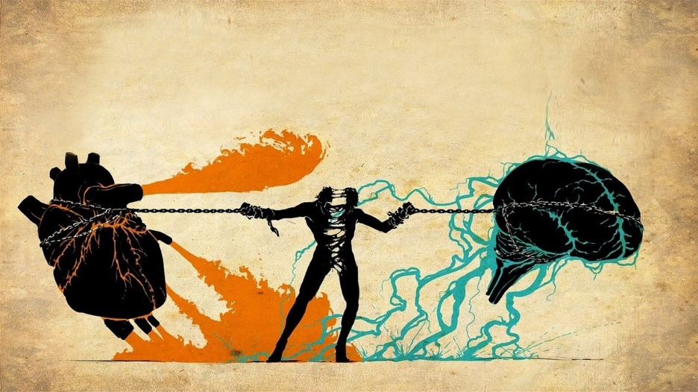
Dualism in the 21st Century
What is the current situation?
Mind–body dualism still has strong echoes in certain domains
E.g., consciousness science: in the existing debate about the relationship between neural processes and conscious experience (the “hard problem of consciousness”; Chalmers, 1995)
Current situation
In cognitive neuroscience & psychology, overall agreement over the fundamental role of bodily processes in shaping cognition
Future comeback?
Reemergence of dualism with views imported from the social sciences (e.g., identity is a fundamentally social construct orthogonal to biological determinants)
AI systems? Advanced cognition without biological bodies?

Slide 7
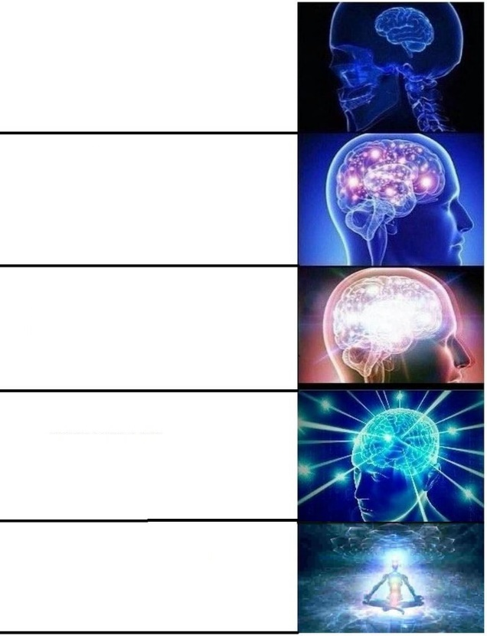
Psycho + Physio?
Embodied cognition: Cognition is shaped by physiological states and capabilities of the organism
Evidence suggests that the fabric of our reality, our conscious experience and sense of Self is embodied
Research interest in the process of embodiment itself (e.g., through interoception, i.e., the way the mind senses and represents its own physiological state)
Psychophysiology: the study of the relationship between physiological and psychological phenomena (i.e., the way in which the mind and body interact)
Study at school
Learn psychology at uni
Get interested in the role of the body in mental processes
See that there is no distinction between your body and your mind
Accept that there is no you but only the one

Slide 8
Interoception

Slide 9


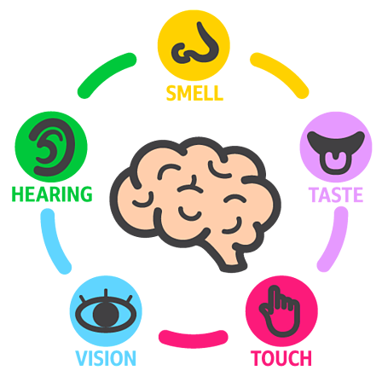



The 5 senses… make little sense
Conscious Experience
« What it’s like to be a bat? » (Nagel, 1974)
Exteroception
Interoception
Taste
Smell
Hearing
Vision
Touch
Body Awareness
Proprioception: Sense of the relative position of one's own body parts
Equilibrioception: Sense of balance and movement (vestibular system)
Interoception
Thermoception: The ability to sense temperature and its changes
Sweat glands (electrodermal activity / skin conductance)
Nociception: Perception of pain
Humoception: Humoral receptors are sensitive to hormones
Visceroception (Interoception)
Bladder
Stomach (hunger, thirst)
Lungs (respiration)
Cardiovascular system (heart)
Sensing of physiological states and changes
Non-human (?)
Magnetoception: sensitivity to magnetic fields
Chemoception - pheromones
Vision – Infrared, ultraviolet
…
Notes:
What about touch?

Slide 10
Interoception Definition
Role
Physiologically, interoceptive signaling is involved in coordinating homeostatic reflexes (e.g., control of blood pressure or glucose levels within a set range) and by guiding predictive (allostatic) autonomic and behavioural responses (e.g., preparing the body for action by increasing blood pressure and heart rate)
Psychologically, interoceptive representations are proposed to underpin both motivational (e.g., hunger) and emotional (e.g., anxiety) feeling states and play an important role in cognition and consciousness (minimal consciousness, sense of reality, …)
Definition
“Interoception is the body-to-brain axis of sensation concerning the state of the internal body and its visceral organs” (Sherrington, 1948)
“Interoception refers to the process by which the nervous system senses, interprets, and integrates signals originating from within the body, providing a moment-by-moment mapping of the body’s internal landscape across conscious and unconscious levels” (Khalsa et al., 2018)
Signaling, processing, representing, and integrating internal bodily states
Notes:
homeostasis = aspects of physiology that maintain life
allostasis = active process of maintaining/re-establishing homeostasis. Dysregulatory (or disordered) form of physiological regulation.

Slide 11
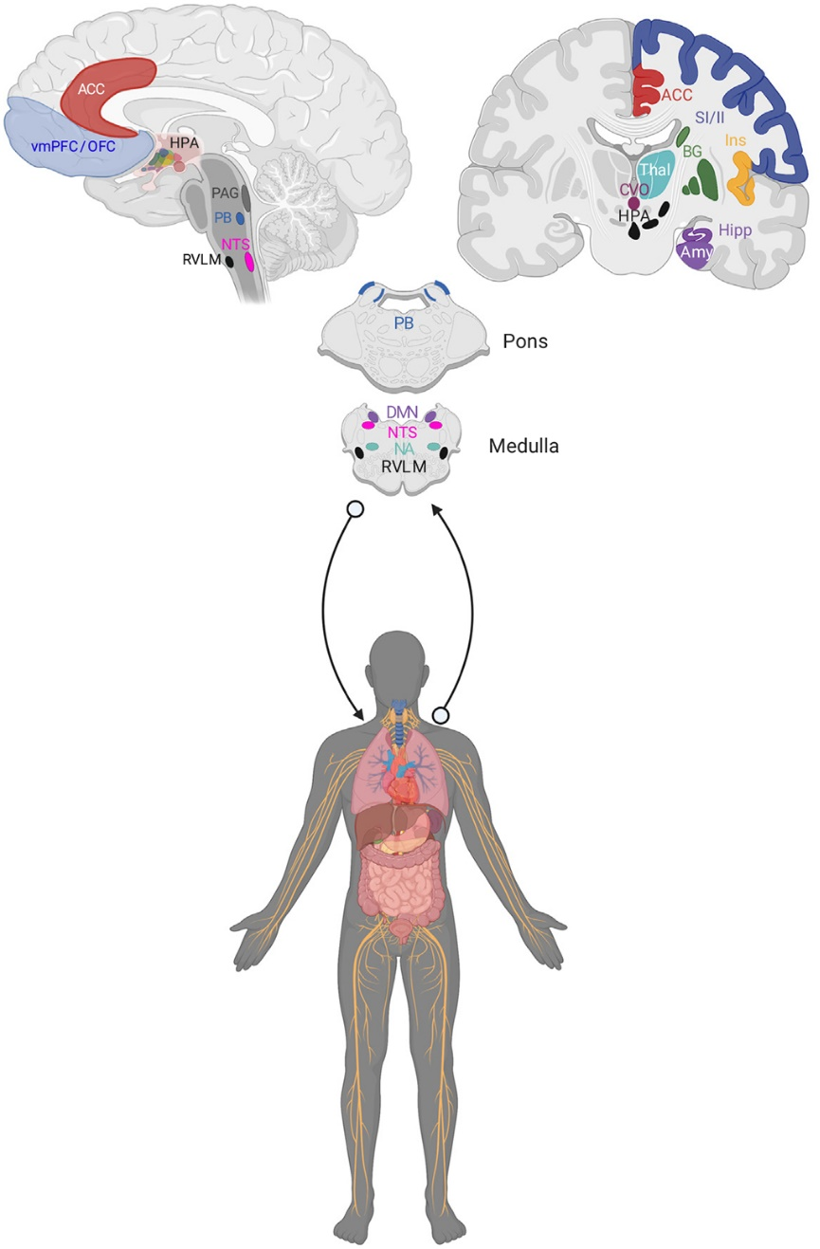
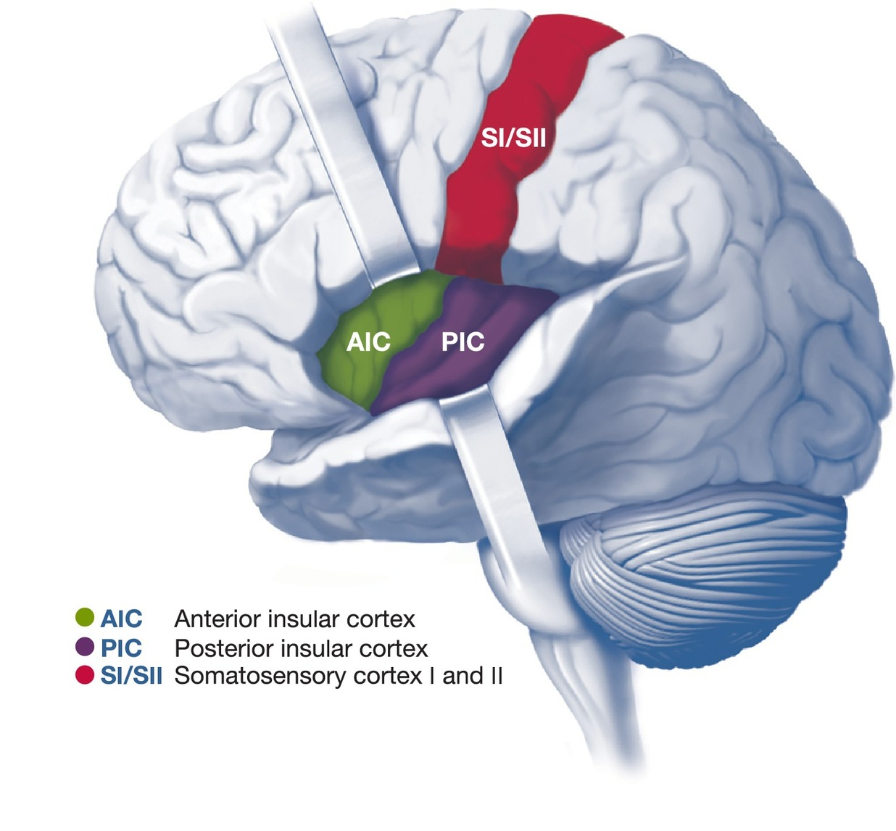
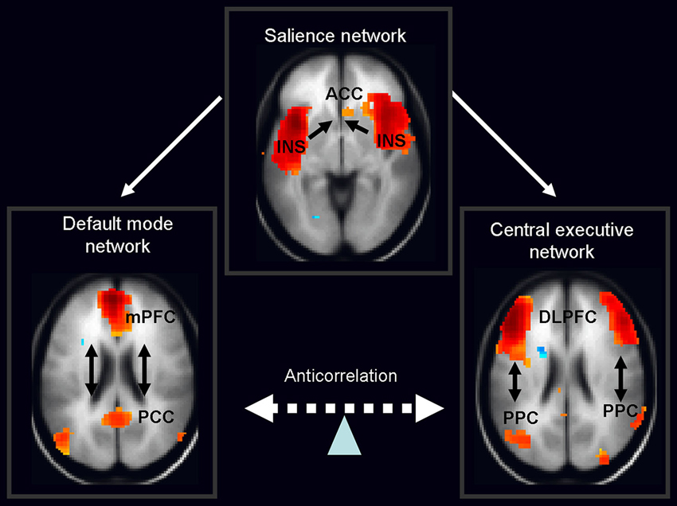
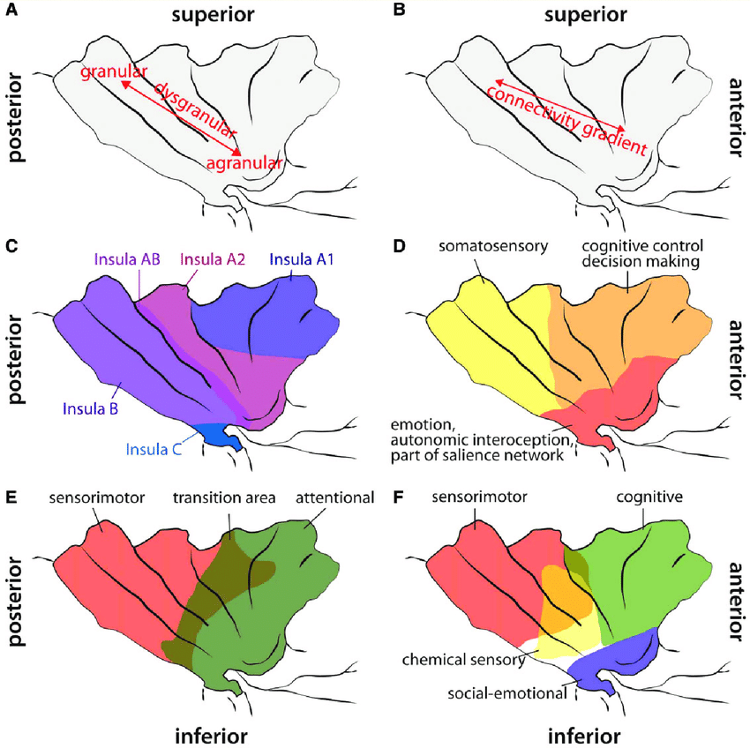
Neural Bases
Receptors (Mechanoreceptors, Chemoreceptors, Baroceptors, …)
The vagus nerve is a major afferent conduit for interoceptive signals (+ also carries parasympathetic efferents)
Subcortical (brain stem, thalamus)
Cortical
Posterior insular cortex (PIC)
Interoceptive information is related from the ventromedial nucleus of the thalamus to the posterior insula
Integration with exteroceptive sensorimotor and proprioceptive information most likely takes place within the posterior / central regions
Anterior insular cortex (AIC)
Strongly connected to orbitofrontal cortex (OFC) and the anterior cingulate cortex (ACC): may be involved in connections between interoceptive and emotional or cognitive states
Postero-anterior insular gradient
The insula is considered to be part of the salience network
Berntson (2021)

Slide 12
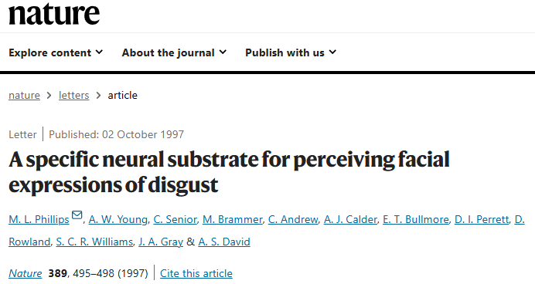
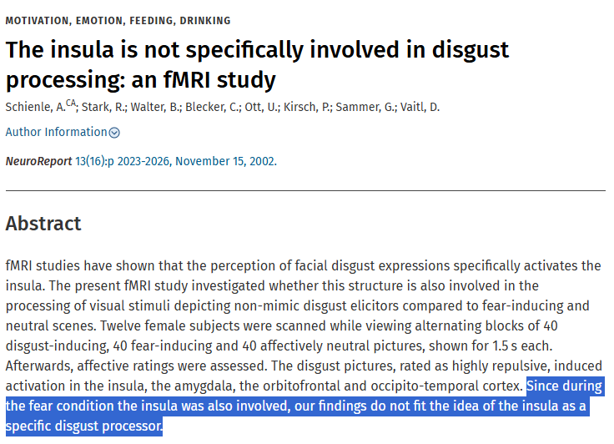
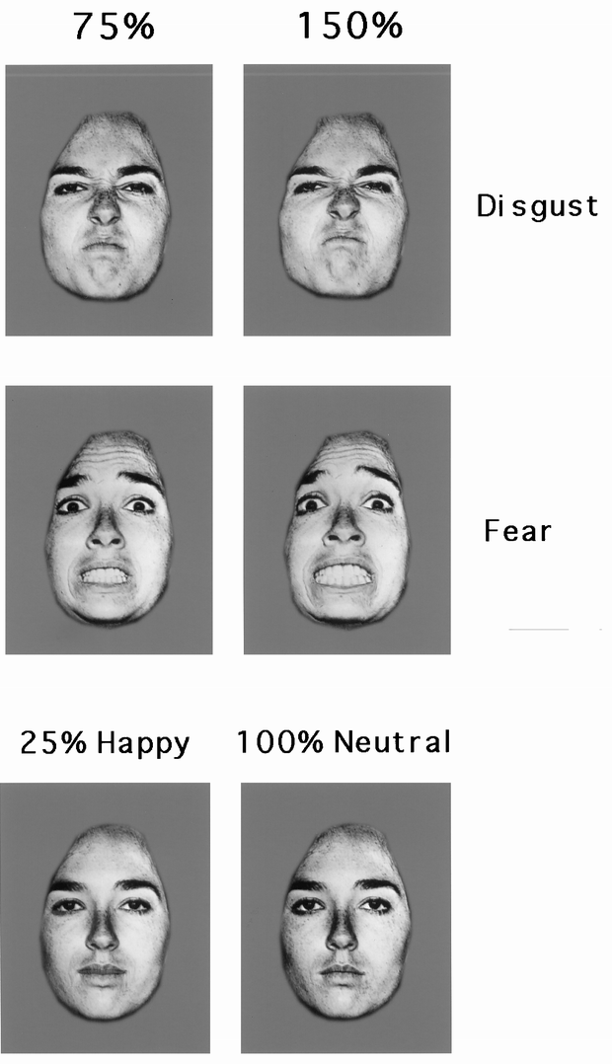
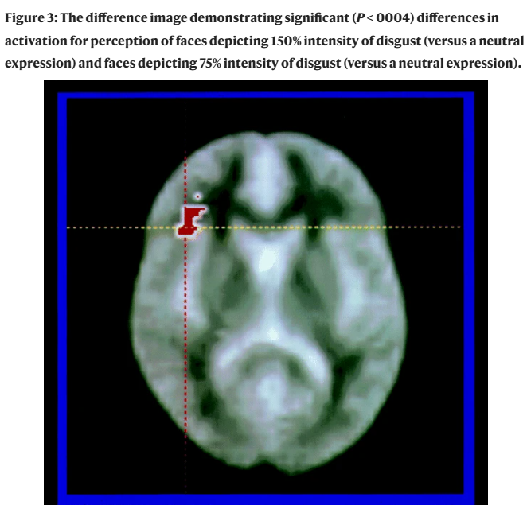

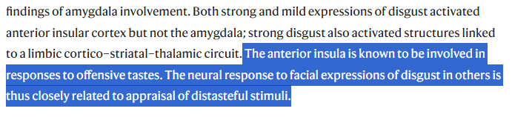
A disgusting history
Disgust vs. Neutral

Slide 13
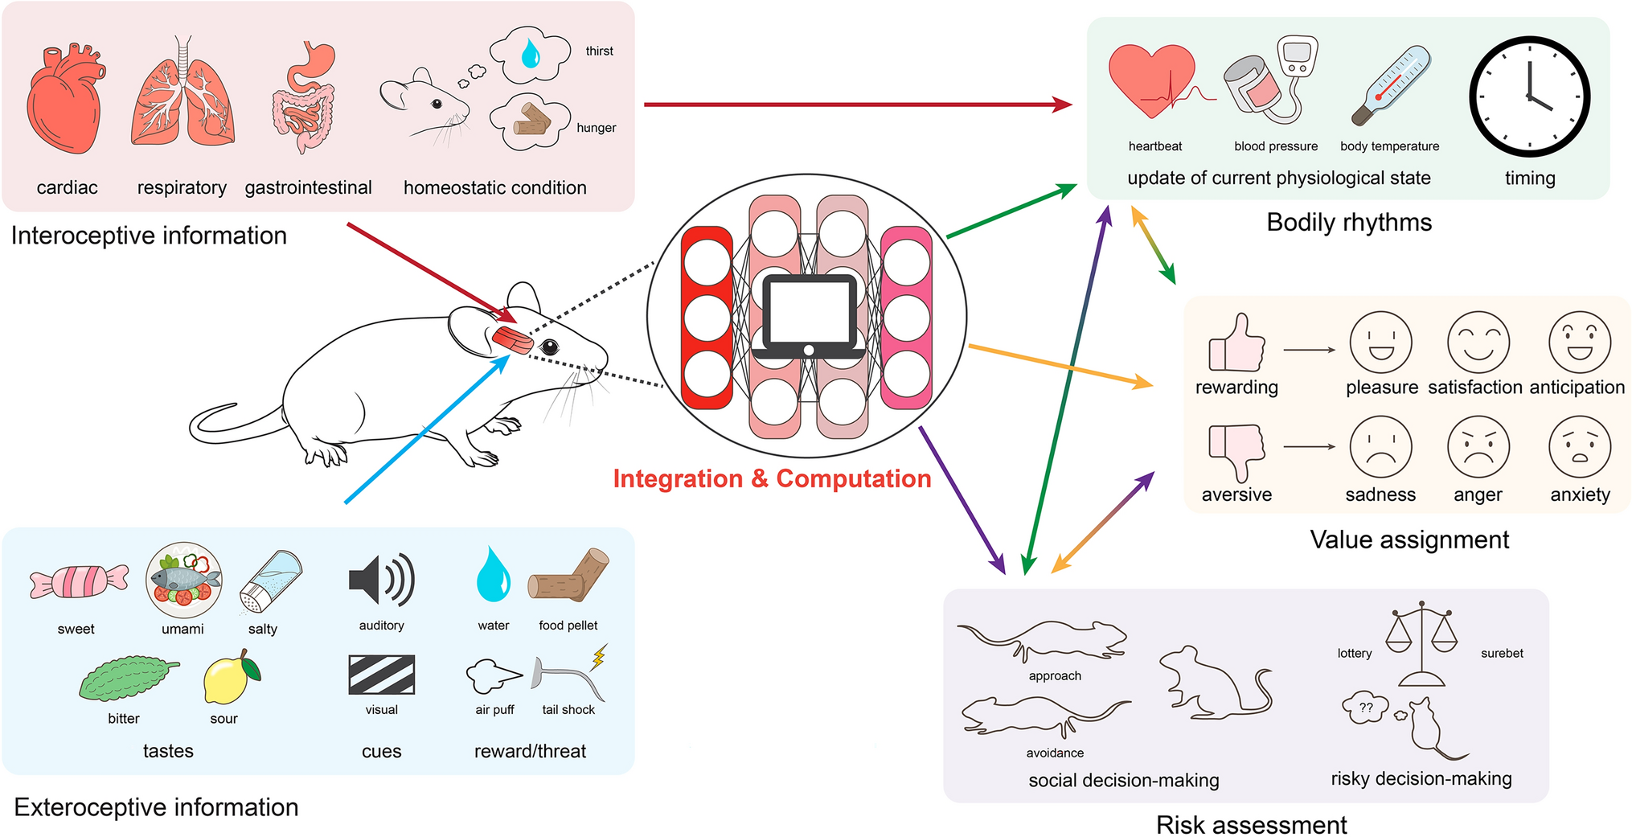
The Insula: A Hub
The insular cortex serves as an integrative hub facilitating seamless interplay between sensation, emotion, and cognition (Zhang, 2024)
Notes:
Zhang (2024) A model illustrating how the insular cortex serves as an integrative hub facilitating seamless interplay between sensation, emotion, and cognition. The insula can receive diverse exteroceptive (e.g., tastes, cues, reward/threat) and interoceptive (e.g., cardiac, respiratory, gastrointestinal conditions, homeostatic states) information through its connection with the sensory areas. The information is then integrated, processed, and computed within the neural network bridged by the insula, influencing the consciousness of self in physical space, updating physiological rhythms (e.g., heart rate, respiration rate), affecting temporal perception, emotional experiences, and guiding decision-making behaviors. The insula evaluates the situational value and potential risk, impacting emotional experiences. Its assimilation of sensory and emotional data guides decisions and behaviors, profoundly influencing personal, social, and reward-driven actions, and defining our interactions with the world.
http://dx.doi.org/10.1007/s12264-024-01211-4

Slide 14

Multidimensional?
Does interoception refer to a single process?
Different levels of processing (unconscious sensing -> conscious and purposeful integration)
Partially distinct physiological pathways
Cardioception – the most studied
Respiroception
Gastroception
…
What about “external” interoception (perception of the body via external senses, e.g., odours from the body, looking at oneself, …)
BUT, information likely integrated at a higher level (?)
Is interoception a unified ability?
🤷
Research is needed, but challenging:
How to measure different facets of interoception?
Often requires specific equipment (e.g., psychophysiological signals recordings)
Notes:
https://www.biorxiv.org/content/10.1101/2021.03.04.433866v2.abstract

Slide 15
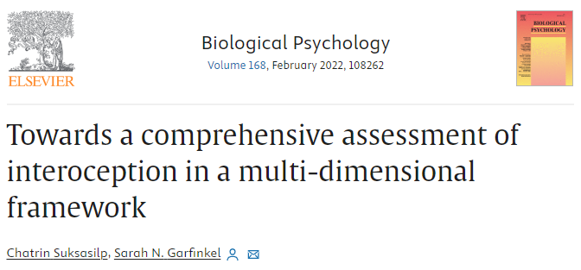
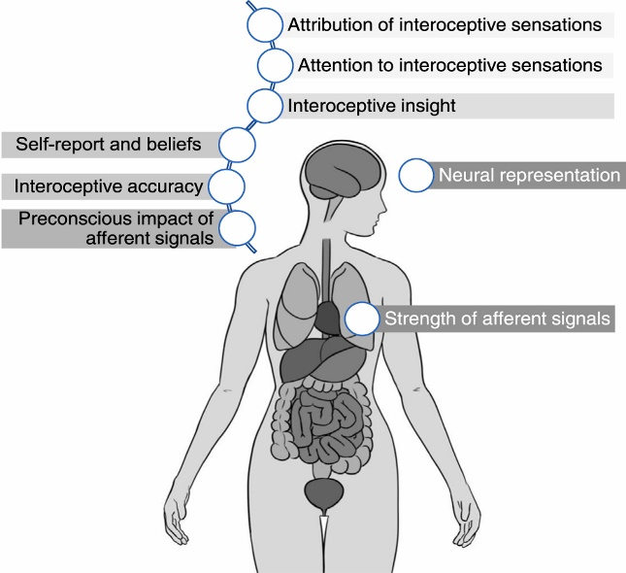
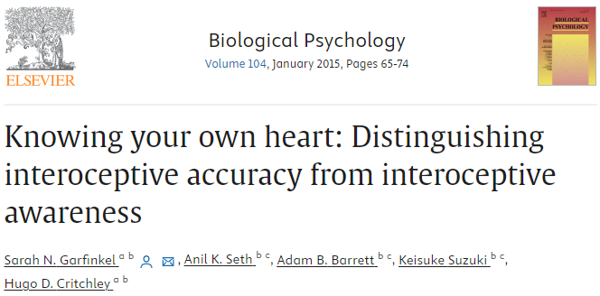
Dimensional models
Interoceptive Awareness
Metacognitive awareness of interoceptive accuracy
3 facets of interoception (Garfinkel et al., 2013, 2014)
Interoceptive Accuracy
Objective performance at interoception tasks
Interoceptive Sensibility
Subjective experience in interoception tasks
Interoceptive Awareness
Metacognitive aspect
Multidimensional model
(Suksasilp, 2022)
Signal strength
Neural representation
Attention orientation
Attribution processes
Beliefs
…
🔥 Active research area
Assessed via subjective awareness of objective accuracy (e.g., correlation between accuracy and sensibility scores)
Interoceptive Accuracy
Objective accuracy in detecting internal bodily sensations
Interoceptive Sensibility
Dispositional tendency to be internally focused; self-reported beliefs about body tendencies
Assessed via objective tests of interoceptive performance (e.g., heartbeat detection tasks)
Assessed via self-report measures (e.g., questionnaires, subjective confidence ratings)

Slide 16
Interoception is an adaptive mechanism
Low interoception is associated with « negative » outcomes (Murphy et al., 2023)
Neuroticism (Pearson & Pfeifer, 2020)
Alexithymia (Gaggero et al., 2021)
Anxiety and panic disorders (Yoris et al., 2015; Eggart et al., 2019)
Eating disorders (Lapidus et al., 2020)
Depression (Eggart et al., 2019)
Borderline Personality Disorder (Flasbeck et al., 2020)
Alcohol and substance abuse (Jakubczyk et al., 2019)
OCD (Schultchen et al., 2019)
Depersonalisation/derealisation disorder (Schulz et al., 2015)
Autism Spectrum Disorder (Nicholson et al., 2019)
ADHD (Kutscheidt et al., 2019)
Schizophrenia (Ardizzi et al., 2016)
Chronic pain (Horsburgh, 2024)
“Those with chronic pain self-report are more interoceptively aware, but less accurate at detecting internal bodily signals”
High interoception is associated with « positive » outcomes
Extraversion, Openness and Conscientiousness (Ferentzi et al., 2020)
Emotion regulation (Füstös et al., 2013)
Mindfulness (Hanley et al., 2017)

Slide 17
Quizz
True / False?
Descartes located the centre of consciousness in the insula
Thanks to science, body-mind dualism is a thing of the past
The Insula is a brain region devoted to « disgust » as one of the 5 basic emotions
The posterior insula is the most tightly connected region with prefrontal cortex
Interoception is a multidimensional construct
Interoceptive awareness corresponds to the accuracy in detecting internal sensations
Having high interoception is bad
It is possible for someone to be « too interoceptive » for its own good

Slide 18
How would you measure interoception?

Slide 19
Direct Measures

Slide 20
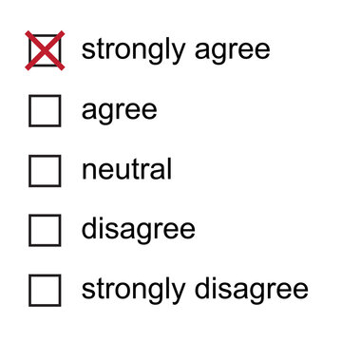
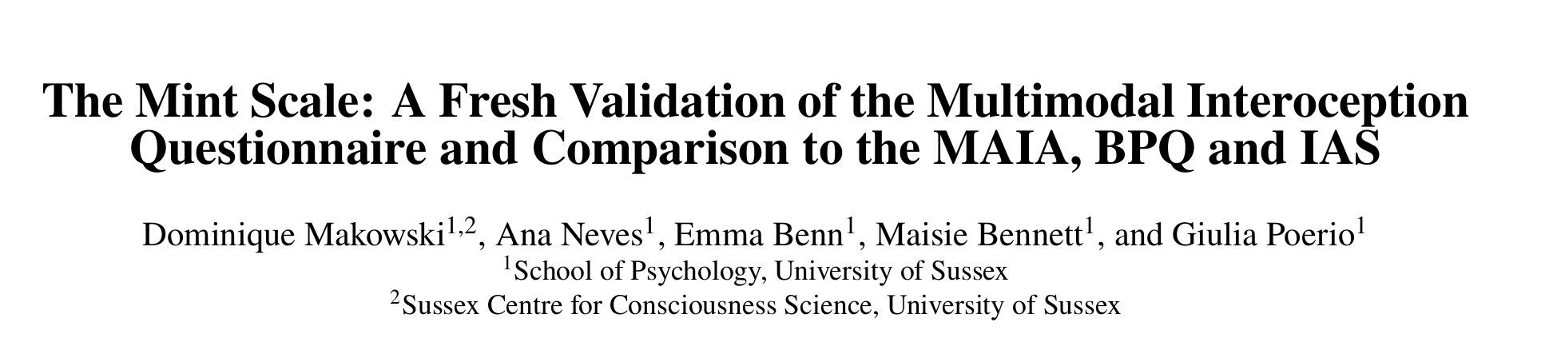
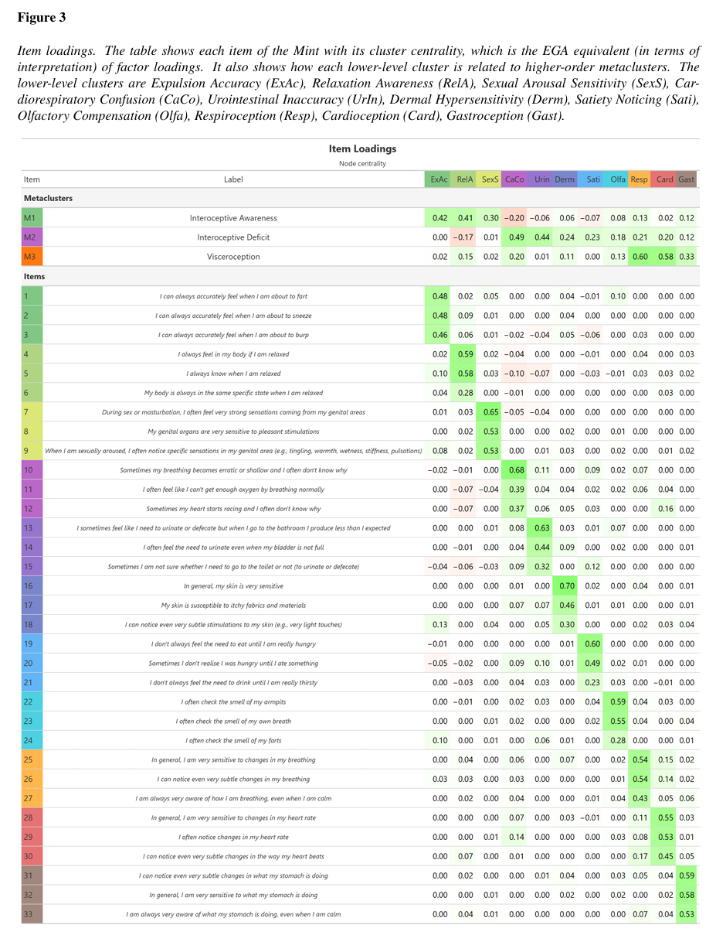
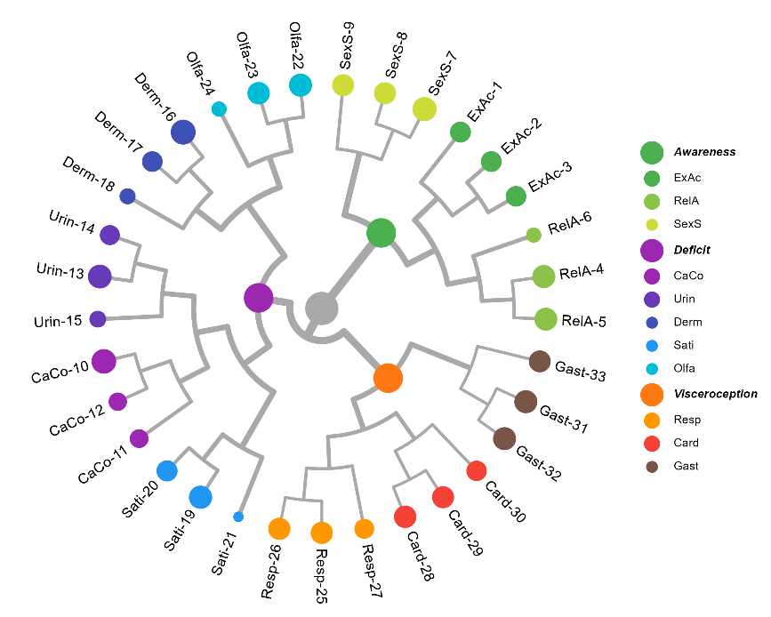
Questionnaires
Questionnaires
Body Perception Questionnaire (BPQ; Porges, 1993)
Awareness of “how hard my heart is beating”
MAIA (Mehling, 2018)
“When I feel overwhelmed I can find a calm place inside”
Interoceptive Accuracy Scale (IAS; Murphy, 2020)
“I can always perceive when my heart is beating fast”
Multimodal Interoception Questionnaire (MINT; Makowski, 2025)
33 items
Superior convergent and predictive validity

Slide 21

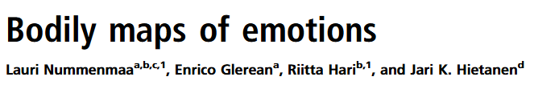
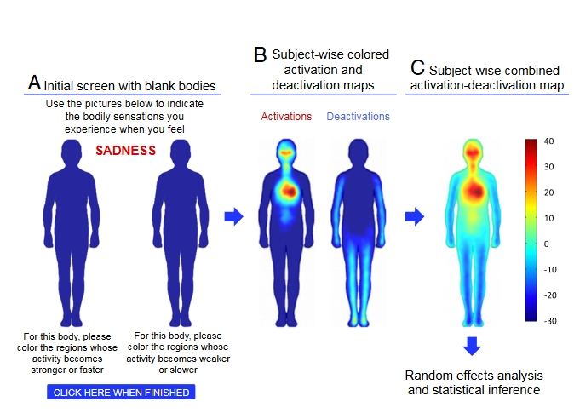
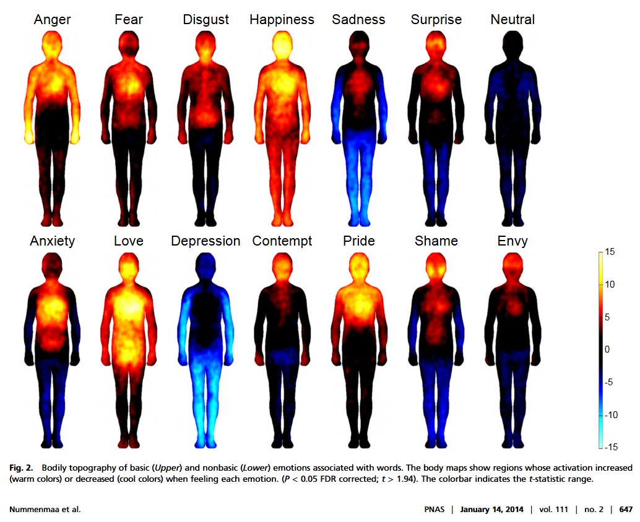
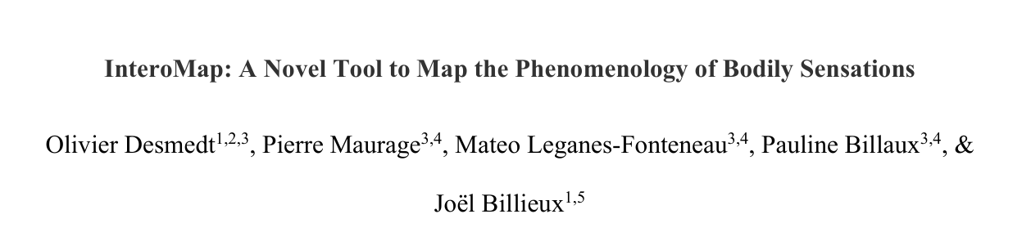
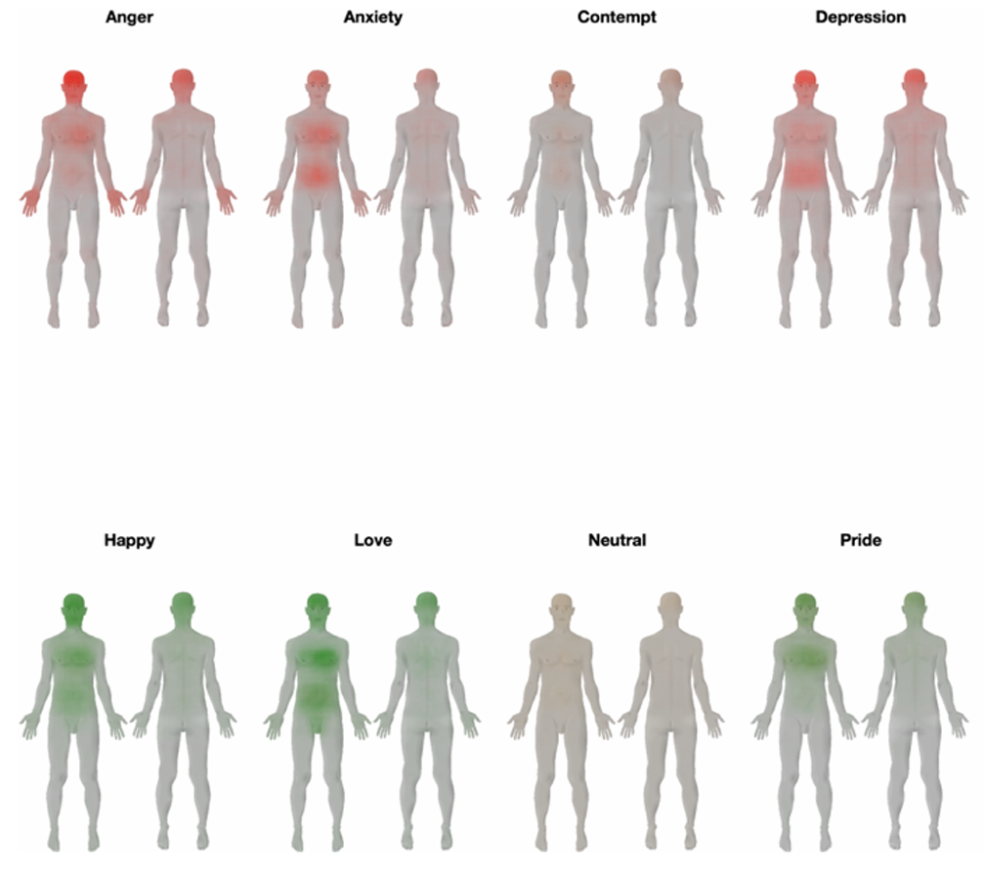
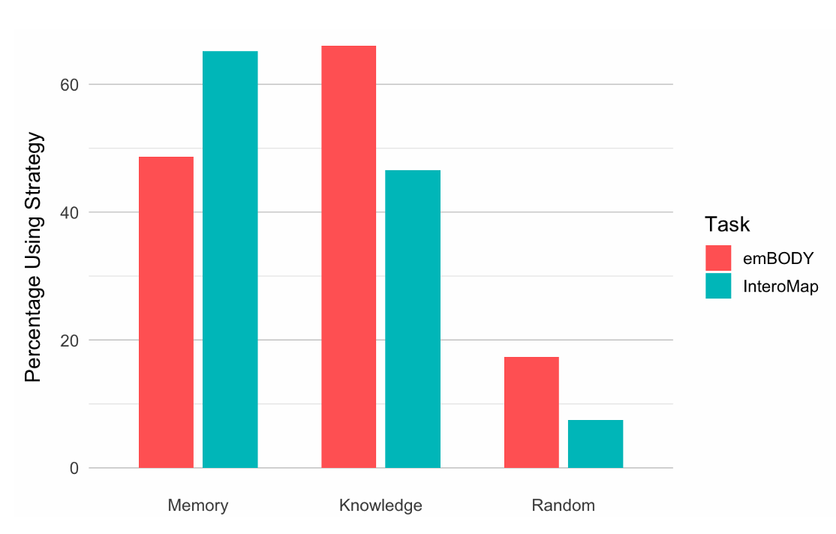
Bodily Mapping
The “emBODY tool” (Nummenmaa et al. 2014)
Participants must draw on the left map to report the sensations that reflect an increase in activity (i.e., activation) and on the right map to report those sensations that reflect a decrease in activity (i.e., deactivation). In this task, the level of intensity is determined by the number of clicks across different locations.
No valence measure (pleasant - unpleasant)
“Increase” / “decrease” of body activity are ambiguous concepts
InteroMap (Desmedt et al. 2025)
“Improved” emBody
Anatomically correct silhouettes
Specify valence and intensity (weak - strong) independently
Validity yet to be demonstrated

Slide 22
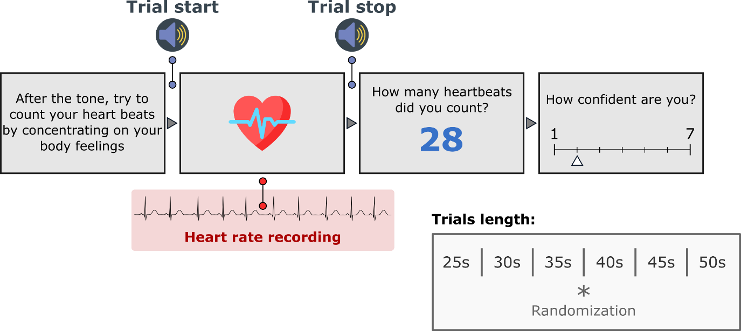
« Objective » Tasks
Cardioception
Heartbeat Counting Task (HCT, Schandry, 1981)
Most popular task
Nicely mapping on the tridimensional model of interoception (Garfinkel, 2015)
Accuracy: counting performance
Sensibility: average confidence
Awareness: correlation between accuracy and confidence
Most criticized

Slide 23
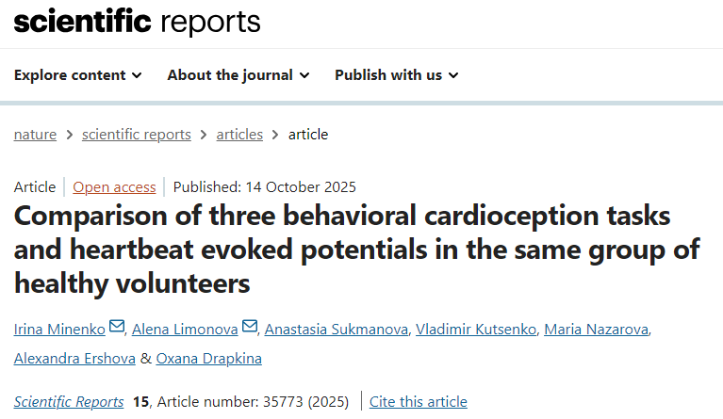
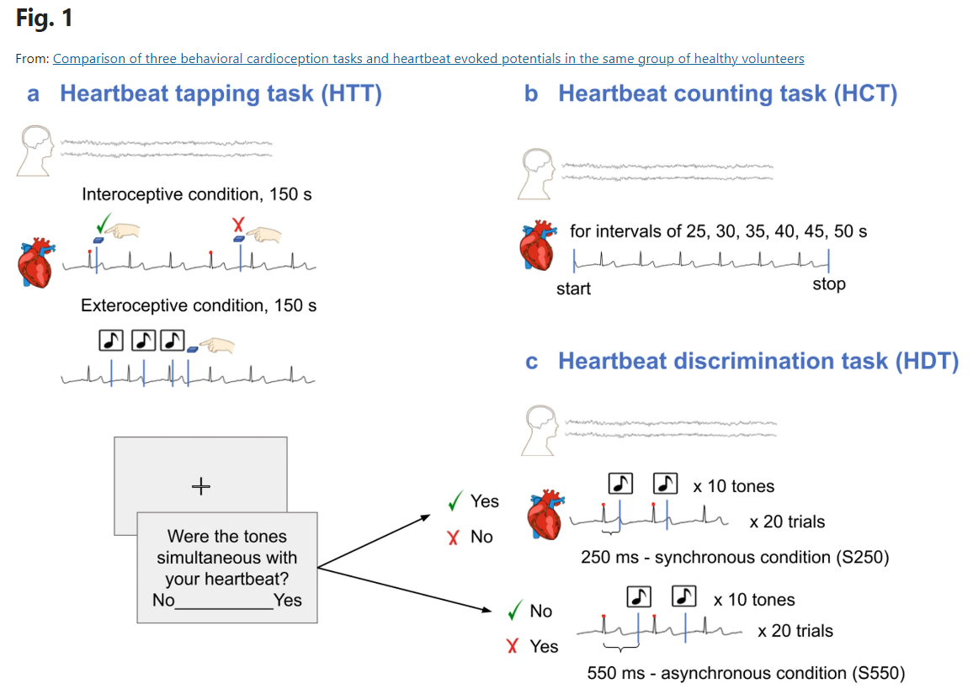
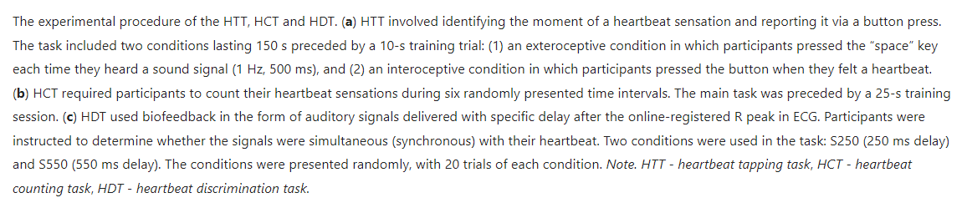
Cardioception
Other Paradigms
Heartbeat tapping
Heartbeat discrimination
HCT, HTT, HDT correlate between them but:
Lack of standardization of the indices extracted
Unclear whether it correlates with other interoceptive measures

Slide 24
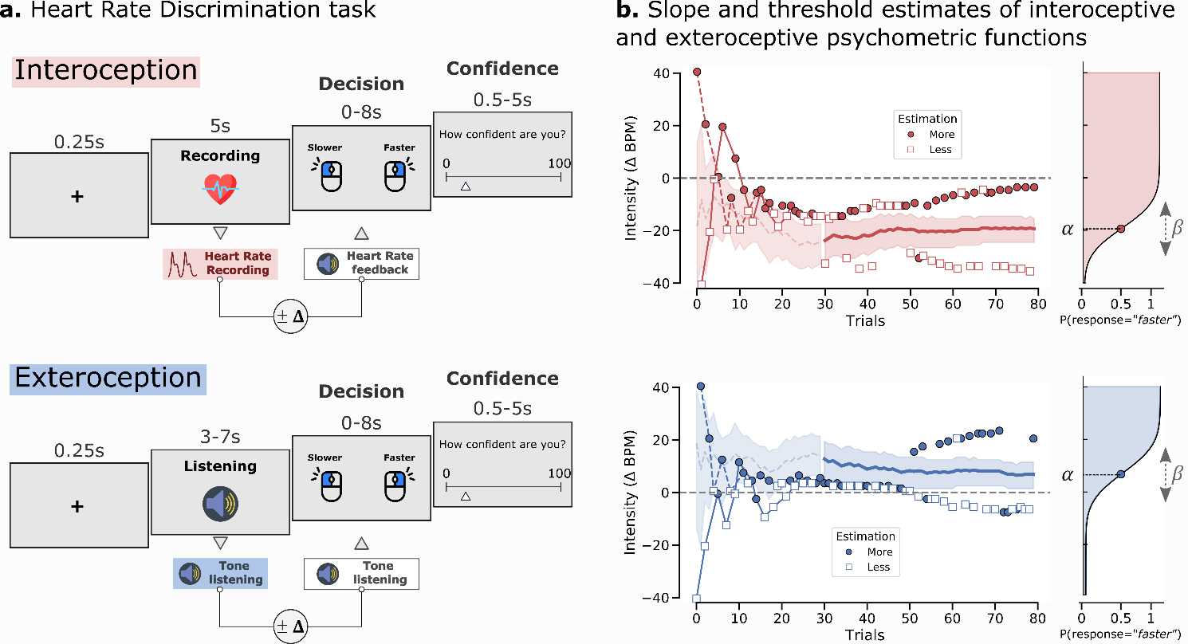
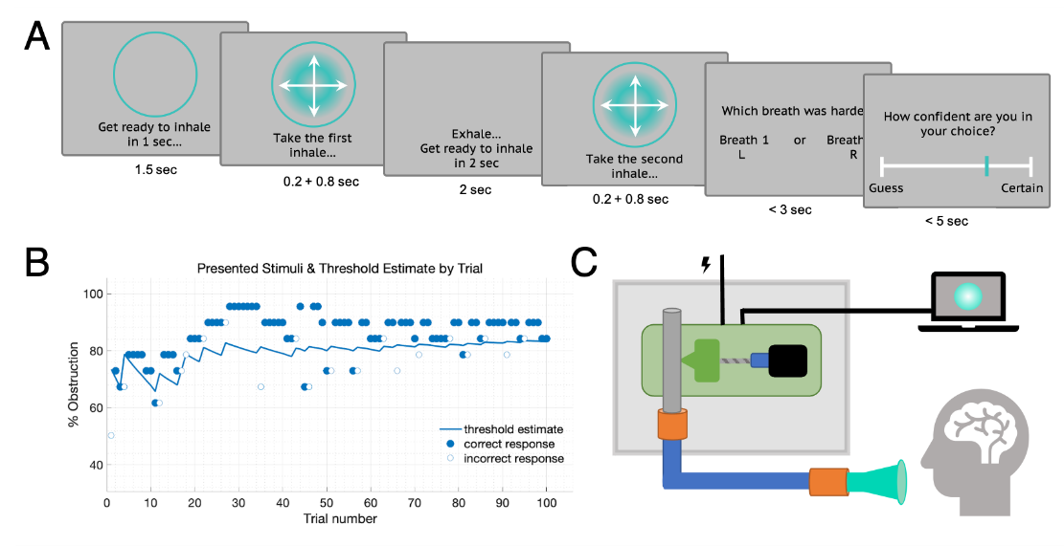
Psychophysics Paradigms
Cardioception
Heart Rate Discrimination Task (Legrand et al., 2022)
Respiroception
Respiratory Resistance Sensitivity Task (Nikolova, 2021)

Slide 25
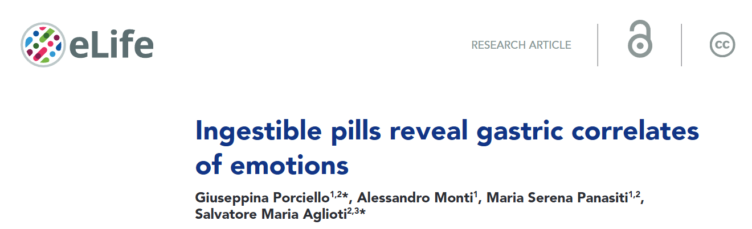
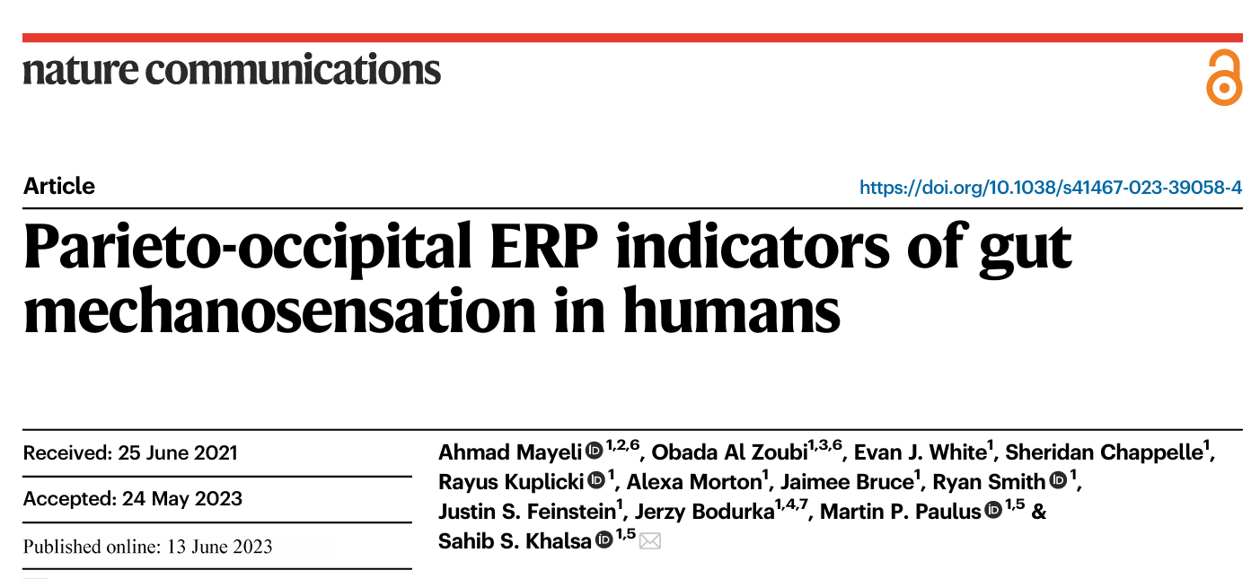
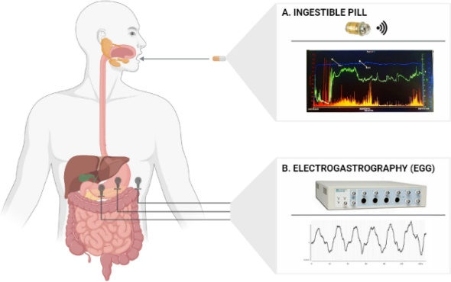
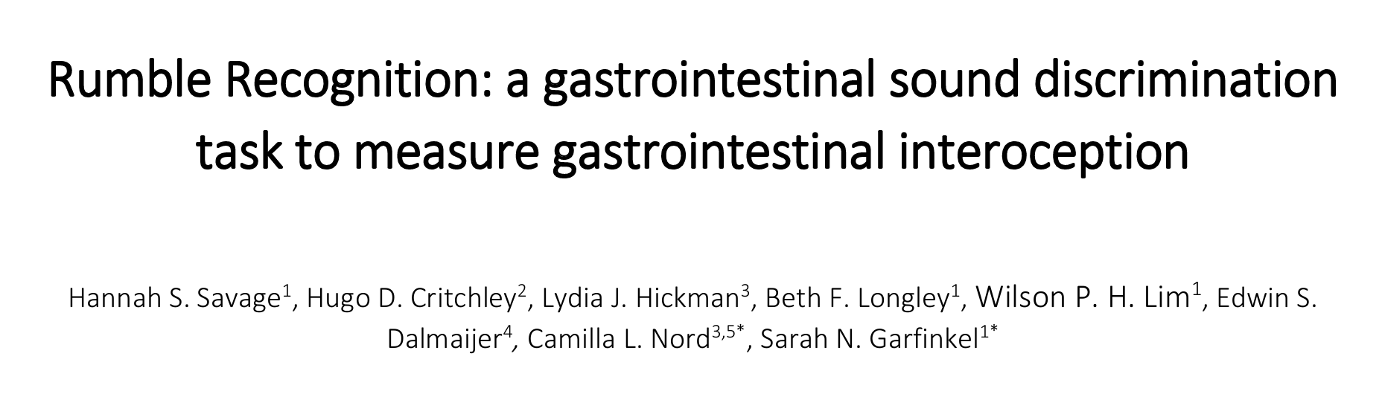
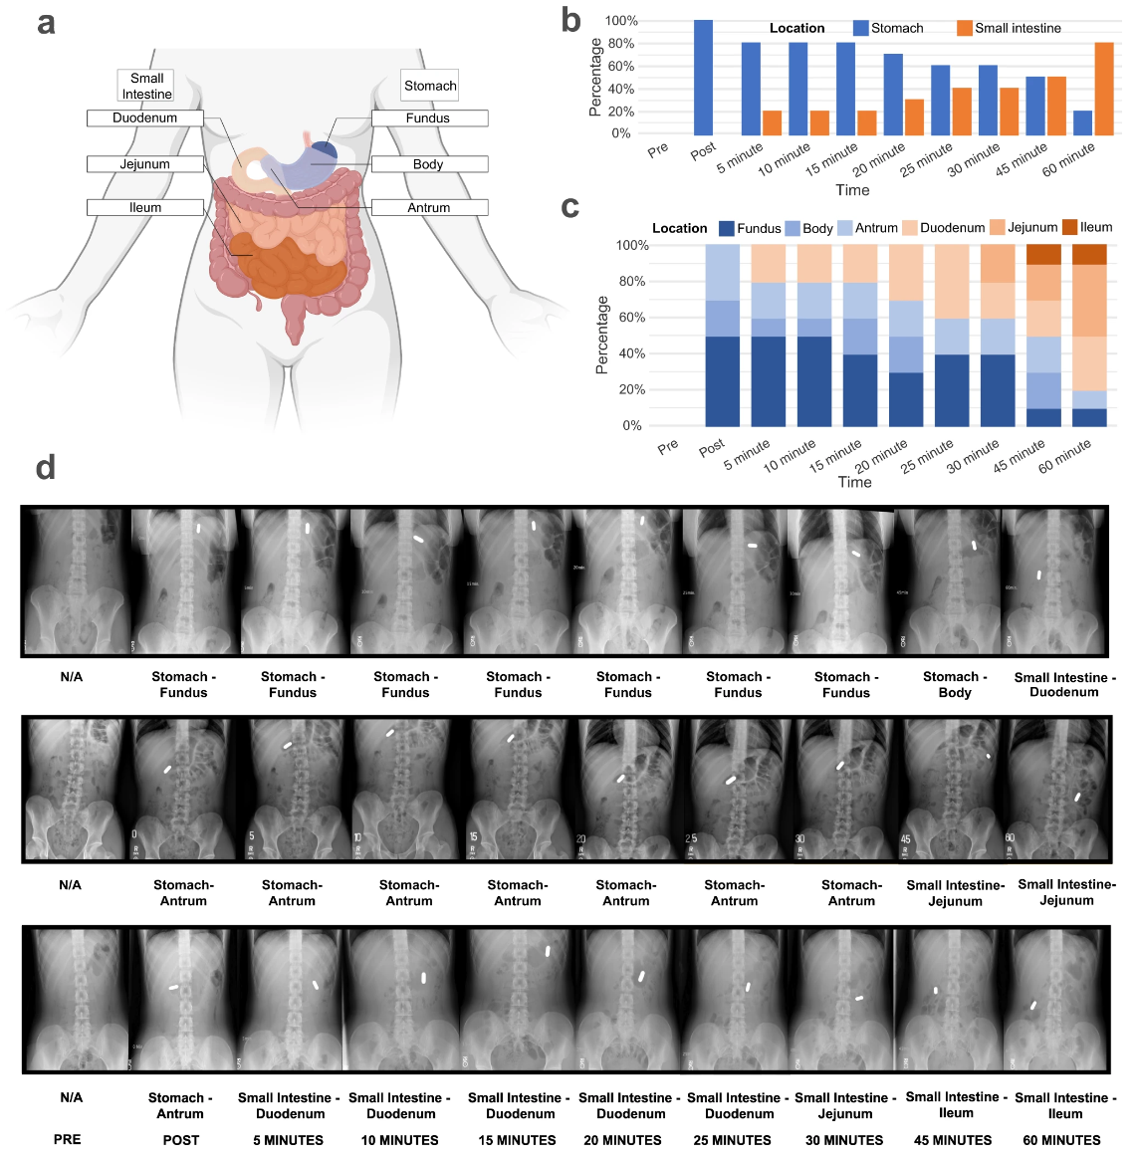
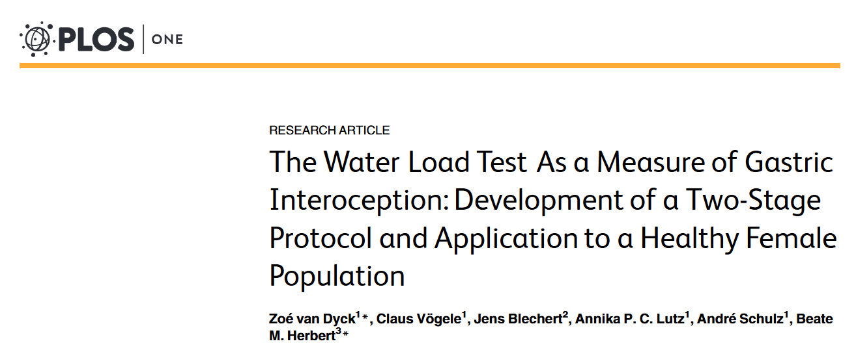
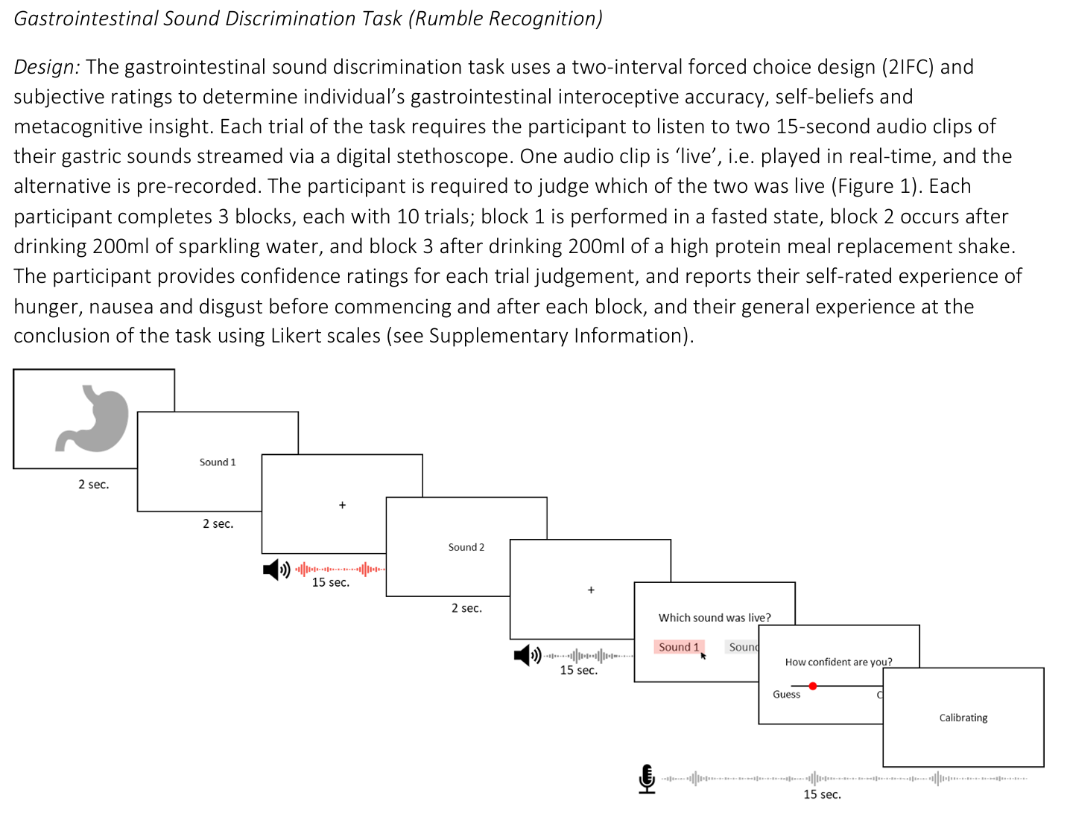
Gastroception
Gastroception
Water Load Test (WLT; Van Dyck, 2016)
Vibrating Pills (Mayeli, 2023)
Smart Pills (Porciello, 2024)
Rumble Recognition (Savage, 2025)
“The WLT-II was performed by asking participants to drink non-carbonated water at room temperature over two successive 5-min periods. During the first period, participants were instructed to drink water ad libitum until reaching the point of perceived satiation, that is, the sensation that determines meal termination. […] During the second period, participants were asked to drink again, this time until reaching the point of maximum stomach fullness. […] Participants were not told that there would be a second drinking phase in order not to influence their first water intake […].”

Slide 26
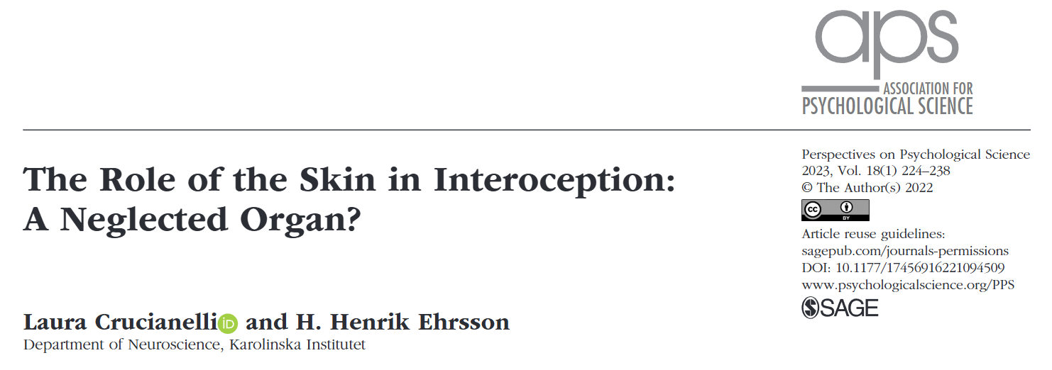
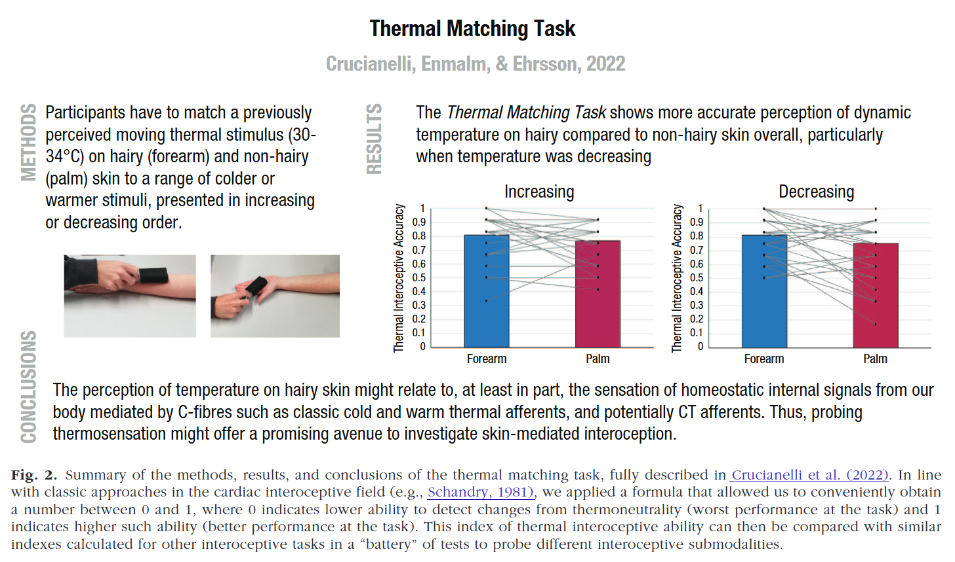
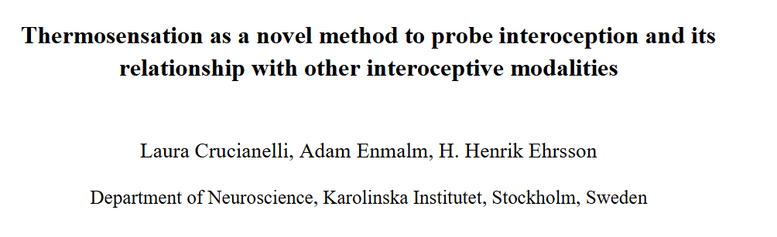
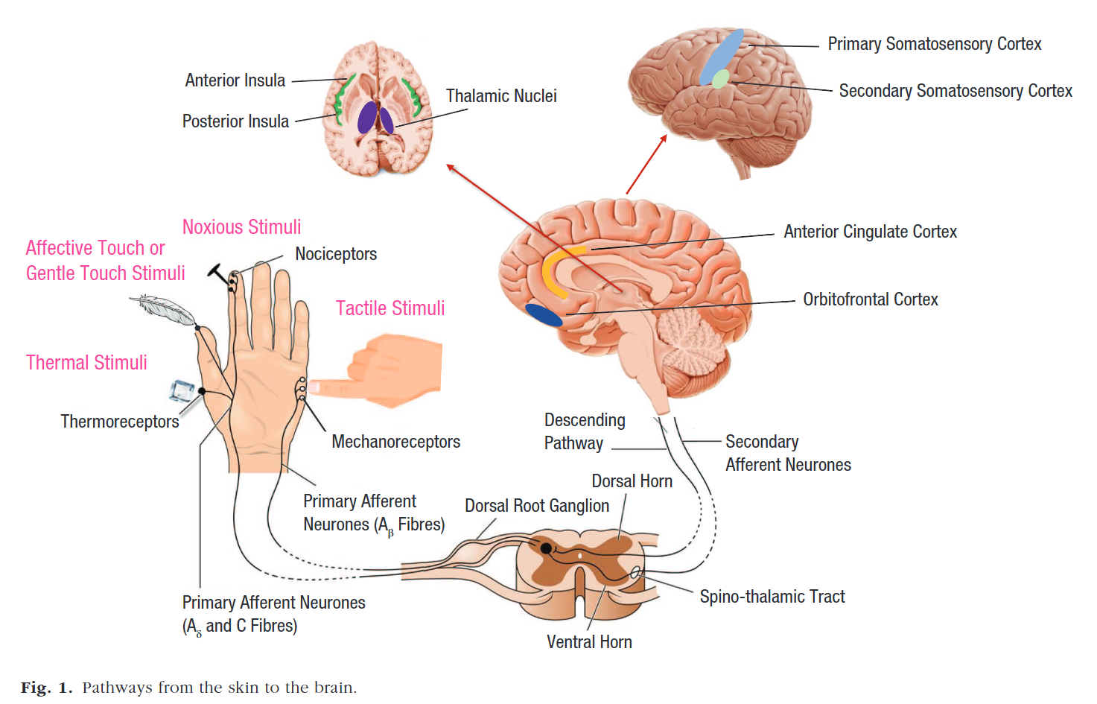
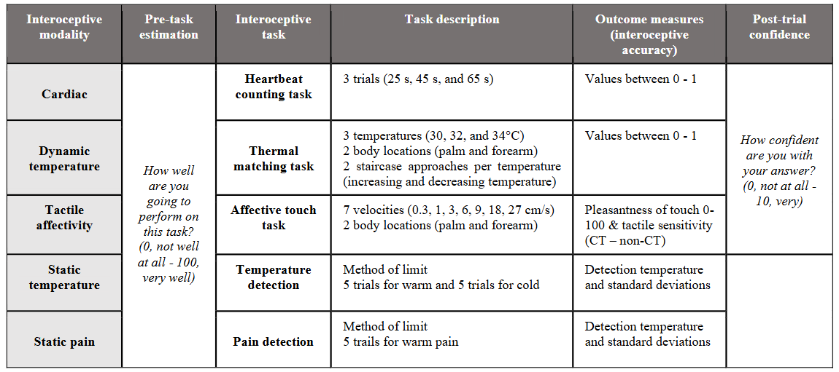


Dermoception / Thermoception
Thermoception
Dynamic Thermoception Task (DTT; Crucianelli, 2022)
“Participants are stroked (on the forearm and palm in random order) with a thermode at reference temperatures of 30°, 32°, or 34 °C and are instructed to verbally indicate when they feel the same temperature again”

Slide 27



Genitoception
Arousal
Genital arousal (Handy, 2016)
Physiological genital arousal
Vaginal Photoplethysmograph
Subjective genital arousal
Continuous ratings
Subjective sexual arousal
Pre-post movie questionnaire
Higher interoception (measured with the MAIA) = greater agreement between 1) physiological and subjective genital arousal and 2) physiological and subjective sexual arousal

Slide 28




Neuroimaging
Heartbeat Evoked Potential (HEP)
Marker of the “processing” of heart beats in the brain
Potentially a direct marker of cardioception
Temporal gradient
The early components of HEPs could be related to primary interoceptive processing (right insula and posterior cingulate) (Plantard, 2025)
Late components could depend on associative processes related to interoception (frontal cortex and the anterior cingulate cortex) (Plantard, 2025)
But:
Moderate association between HEP amplitude and behavioural measures of interoception (Coll, 2021)
Unclear topology & timing
Lack of standardized protocols
Unclear meaning (only sensory? cognitive elaboration? preconscious?)

Slide 29



HEP Features

Slide 30




HEP Applications

Slide 31
Indirect Measures

Slide 32


Cardiac Phase
Cardiac Phase (most studies focus on ventricular phase)
Systole (ventricular)
Blood is ejected through the arteries
Arteries expansion activates the baroreceptors (pressure sensors)
Cardiac state (strength and timing) is relayed to the brain
Diastole
During diastole baroreceptor are quiescent
Technical Point
ECG Signal Delineation
Identifying the location (+ beginning / end) of QRS waves
Important for precise cardiac phase identification
Systole = from R-peak to end of T-wave
Hard to do algorithmically (+ requires good signal)
Heuristics have been used (e.g., systole 0-300 ms post R-peak)
But do not take into account inter & intra-individual variability

Slide 33





Cardiac Phase influences Behavior
Evidence suggesting that behavior is coupled with the cardiac phase
Motor action (Palser, 2021)
Participants were found to unconsciously initiate voluntary movements (and anticipate the movements of others) during the diastole phase (when the heart is relaxed) to avoid the sensory dampening that occurs during systole
Information gathering (Galvez-Pol, 2022)
During active tactile discrimination tasks, subjects coupled their exploratory finger movements to cardiac diastole, effectively 'listening' with their fingertips only when internal physiological noise was lowest.
Visual search (Galvez-Pol, 2020)
Eye movements (saccades) during visual search were found to be synchronized with the heart, initiating shifts in gaze during systole so that the subsequent visual fixation occurs during the quieter diastole phase
Notes:
Palser, E. R., Glass, J., Fotopoulou, A., & Kilner, J. M. (2021). Relationship between cardiac cycle and the timing of actions during action execution and observation. Cognition, 217, 104907
Galvez-Pol, A., Virdee, P., Villacampa, J., & Kilner, J. (2022). Active tactile discrimination is coupled with and modulated by the cardiac cycle. Elife, 11, e78126
Galvez-Pol, A., McConnell, R., & Kilner, J. M. (2020). Active sampling in visual search is coupled to the cardiac cycle. Cognition, 196, 104149

Slide 34




Cardiac Phase: Effect on Cognition
Mechanism
During the cardiac ejection period (systole), arterial baroreceptors signal cardiovascular arousal to brain stem (medulla), which is then relayed to other regions, such as the anterior cingulate cortex (ACC), amygdala and insula (but anatomo-functional link between cardiac phase and brain activity still poorly understood)
Effects
“Inhibitory effect” of systole (Lacey and Lacey, 1978)
Nociception attenuated during systole (Edwards, 2001, 2002)
Memory encoding worse during systole (Garfinkel, 2013)
Time perception contracts during systole (Arslanova, 2023)
Emotions (Garfinkel, 2014)
Cognitive control (Makowski, 2020)
Awareness (Park, 2014)
🔥 Hot topic of research

Slide 35


Cardiac Phase: Standardization
Large differences between studies
Estimated-Latency vs. Physiological approach
Various latencies
Various recording approaches (ECG vs. PPG)
Lack of standardization

Slide 36
Measuring Interoception
Direct
Capturing interoceptive processes
Indirect
Measuring the coupling between physiology and neurocognition
Objective
Signalling and processing aspects
Subjective
Conscious metacognitive interpretation
Ability level
Characteristics related to coupling
Mechanism level
Measures of
psychophysiological coupling
Implicit
Bypass conscious & metacognitive processes
Explicit
Ask participants to consciously attend interoceptive processes
Examples
of measures
EEG
Heartbeat Evoked Potentials (HEPs)
Tasks
Heartbeat Counting Task
Heartbeat Tracking Task
Heartbeat Discrimination Task
…
Questionnaires
MAIA, IAS…
Self-reports
Scales of confidence / performance
Assessment of related traits
Emotional reactivity / regulation (?)
Alexithymia (?)
Mindfulness (?)
…
Physiological indices
Heart Rate Variability (HRV)
Effect of cardiac phase
…

Slide 37



Measuring Interoception
Interoception is part of a multilevel, multidirectional system
Different « domains/topics » of research are actually measuring it
Ability to notice, detect and integrate bodily changes
Questionnaires
Accuracy paradigms
Primary “interoception” literature
Effect of bodily states on cognition
Effect of the cardiac phase
Cognition
Brain
Brain-body coupling
Baroreflex
Vagal tone (respiratory sinus arrhythmia)
Heart rate variability (HRV)
Brain correlates of bodily changes
Heartbeat evoked potentials
Neural correlates of physiological changes / states (emotions)
Body

Slide 38
Quizz
True / False?
There is only one proper way of measuring interoception
Subjective measures (e.g., questionnaires) of interoception are by definition invalid
The heartbeat counting task is the most popular interoception task
Interoceptive sensibility is often measured using the confidence scale in HCT paradigms
There are no interoceptive tasks for other modalities like the gut
Heartbeat evoked potentials are the brain waves happening at the time of R-peaks
Systole corresponds to the blood ejection phase
Interoception is a concept at the « heart » of modern cognitive psychology, and attracting a lot of interest

Slide 39

Thank you
Dominique Makowski
D.Makowski@sussex.ac.uk

